Slide 1

Job Market Analysis Using SQL Server
PROFILE DATA

Slide 2
Introduction
This project analyzes job market trends in Egypt using SQL Server by exploring custom-generated data to extract insights on hiring, salaries, and in-demand skills.

Slide 3
01
Overview

Slide 4

Project Overview
"Job Market Analysis Using SQL Server" is a data-driven project that explores hiring trends, salary ranges, and in-demand skills in Egypt by executing structured SQL queries on a custom-built relational database.
Main Idea: The system simulates real job market data, covering job posts, companies, locations, skills, and experience levels, to support pattern discovery and informed decision-making.
Problem Statement: Job seekers and HR professionals often lack clear, data-backed insights into market trends, salaries, and required skills, which hinders effective career planning and recruitment.
Proposed Solution: Using SQL Server, the project offers actionable insights through structured queries that help users understand labor market dynamics and make better choices.
Target Audience: Job seekers, HR departments, and data analysts in Egypt’s job market.

Slide 5
02
Objectives

Slide 6

Project Objectives
Design and implement a relational database system that realistically simulates key aspects of Egypt’s job market.
Develop a well-structured and scalable schema to represent core entities such as companies, job listings, geographic locations, required skills, and experience levels.
Utilize structured SQL queries to perform in-depth data analysis and generate actionable labor market insights.
Enhance analytical accuracy and efficiency through comprehensive data profiling, ensuring consistency, validity, and readiness for querying.
Provide meaningful insights to job seekers, HR professionals, and decision-makers regarding hiring trends, salary expectations, and in-demand skills.

Slide 7
03
DB Schema

Slide 8
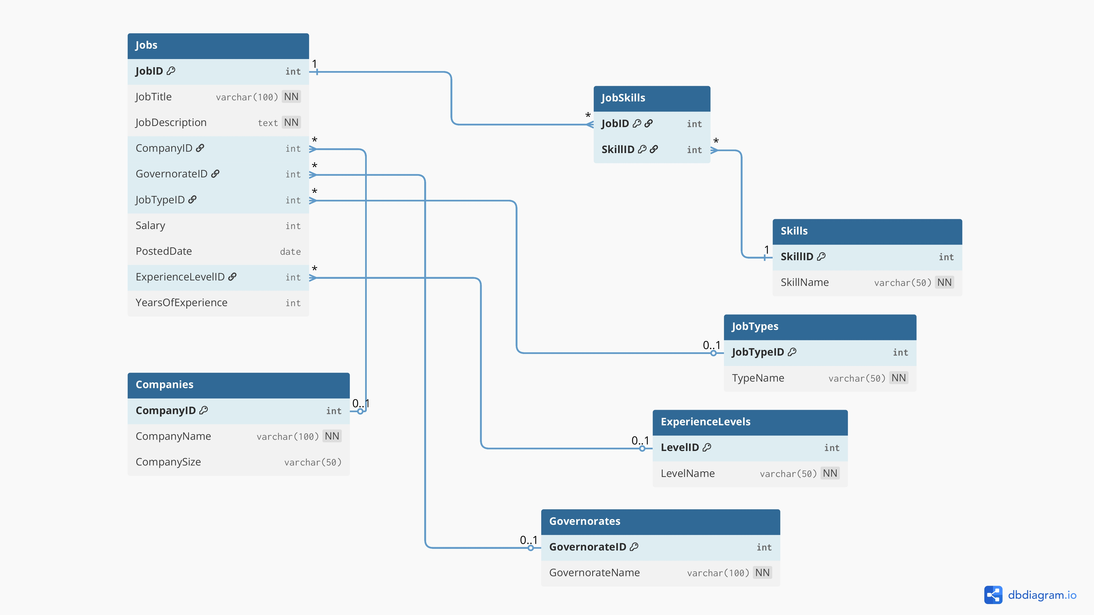


Slide 9
04
Data Generation

Slide 10
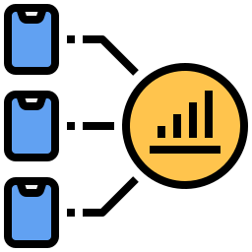

Data Generation
The data used in this project was manually generated by me. I didn't use any external dataset, instead, I created a custom dataset that reflects realistic job market scenarios as accurately as possible. This allowed me to:
Customize the data to fit my project objectives.
Ensure it includes diverse roles, companies, and locations.
Simulate real-world patterns in job postings, salaries, experience levels, etc.
I mainly used 7 tables in this project, which are:
Companies
Governorates
JobTypes
ExperienceLevels
Jobs
Skills
JobSkills

Slide 11
05
Tables Overview

Slide 12
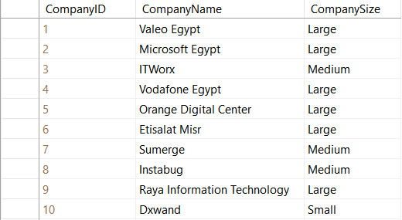
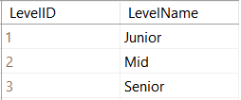
Data Generation
To give you a clearer idea about the structure and content of the data, I'll now show a simple sample from each table to illustrate how the data looks. These samples represent just a small portion of the overall data :
Companies Table
ExperienceLevels Table

Slide 13
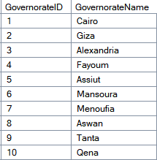
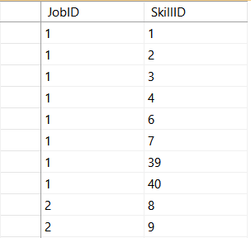
Tables Overview (Cont.)
To give you a clearer idea about the structure and content of the data, I'll now show a simple sample from each table to illustrate how the data looks. These samples represent just a small portion of the overall data :
Governorates Table
JobSkills Table

Slide 14
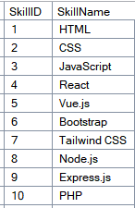
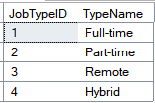
Tables Overview (Cont.)
To give you a clearer idea about the structure and content of the data, I'll now show a simple sample from each table to illustrate how the data looks. These samples represent just a small portion of the overall data :
JobTypes Table
Skills Table

Slide 15
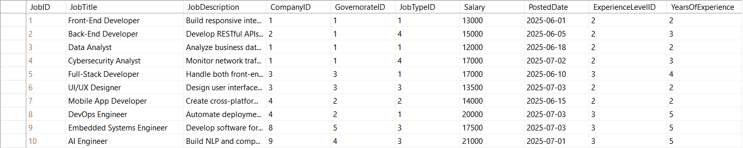
Tables Overview (Cont.)
To give you a clearer idea about the structure and content of the data, I'll now show a simple sample from each table to illustrate how the data looks. These samples represent just a small portion of the overall data :
Jobs Table

Slide 16
06
Data Profiling

Slide 17

Data Profiling Summary
Before starting the analysis, I conducted data profiling to explore and understand the structure and quality of the data. This helped me build a strong understanding of the data before drawing any insights.
The profiling process included the following steps:
Retrieving the number of columns in each table.
Reviewing data types and column properties.
Counting the number of rows in key tables like Jobs and Skills.
Detecting NULL values in the Jobs table.
Getting a statistical summary (Min, Max) for Salary and Years of Experience.
Checking for duplicate or illogical repetitions in job titles.
Counting the number of skills assigned to each job.

Slide 18
Examples
&
Insights

Slide 19
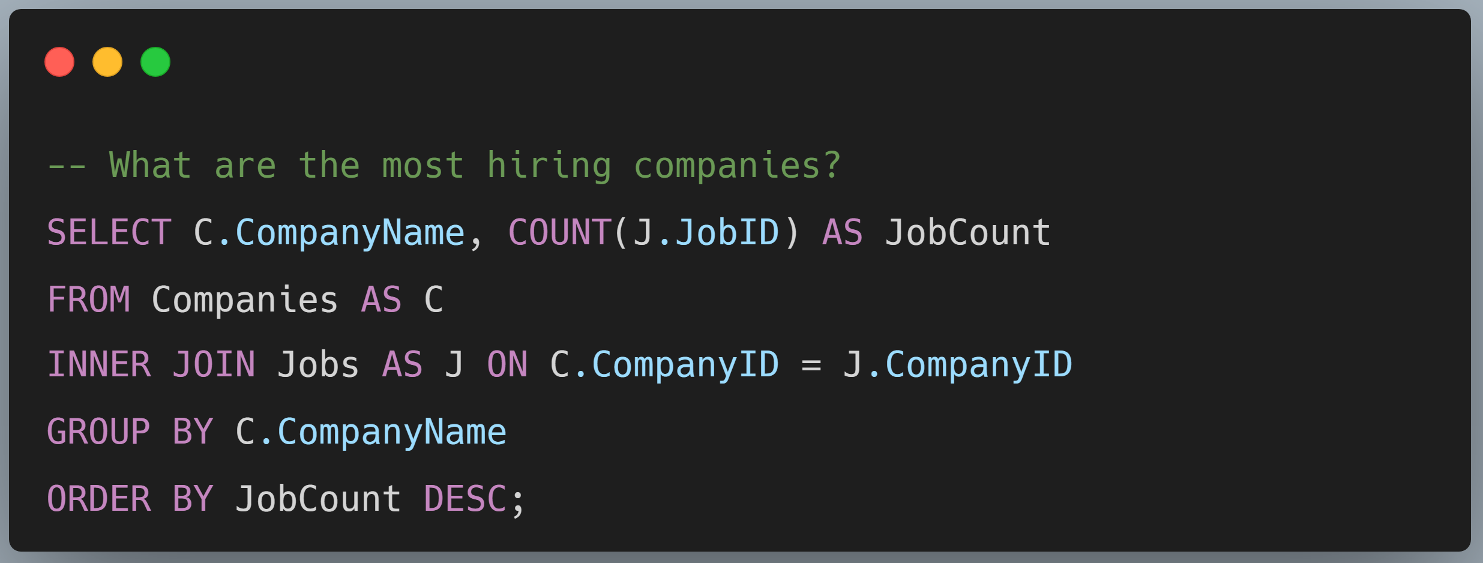

Slide 20
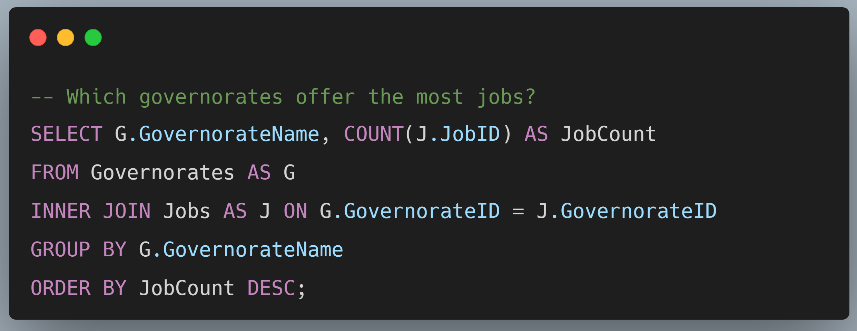

Slide 21
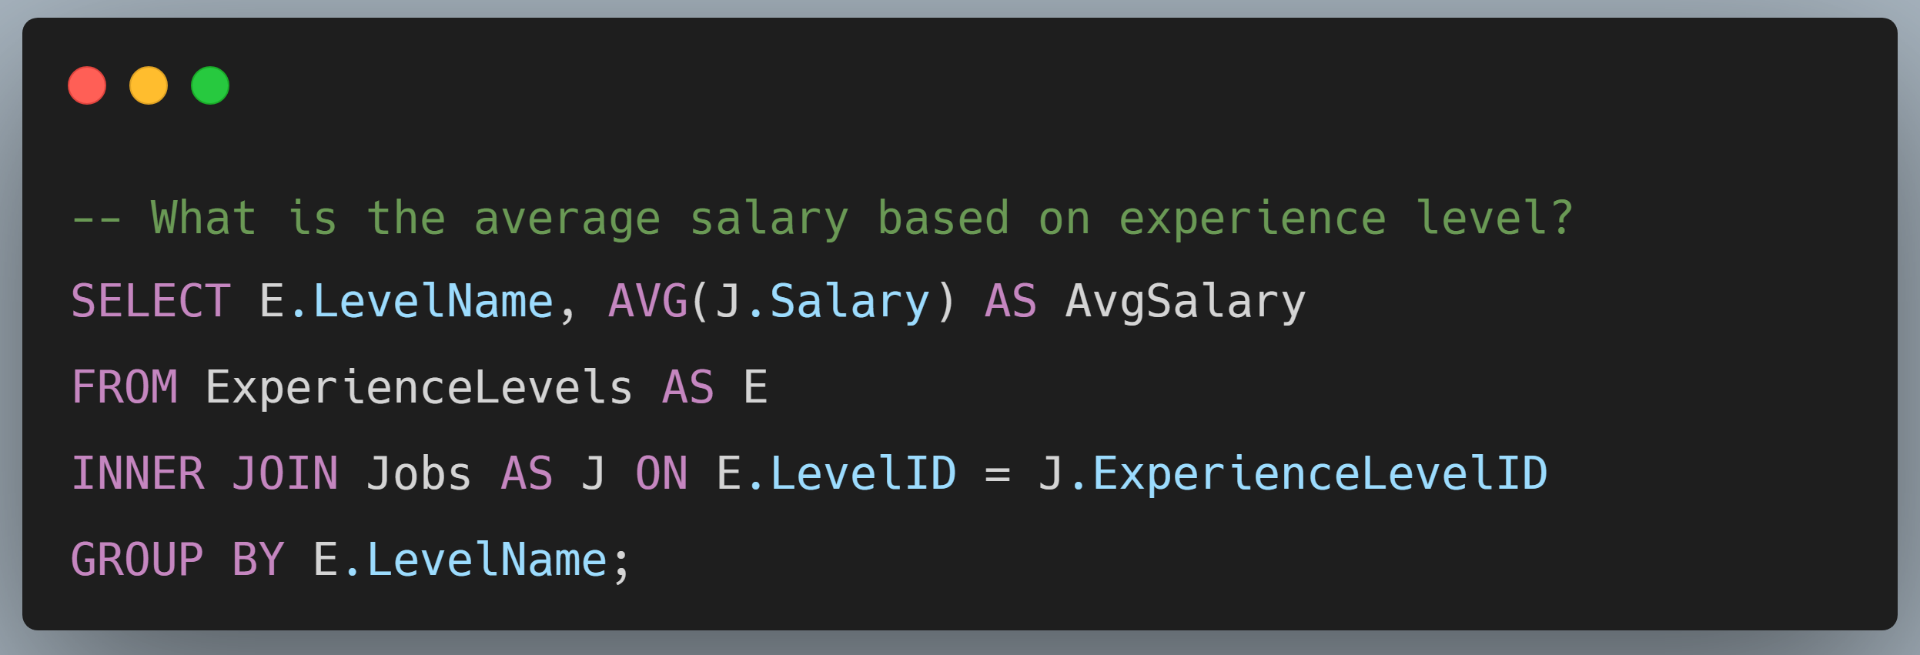

Slide 22
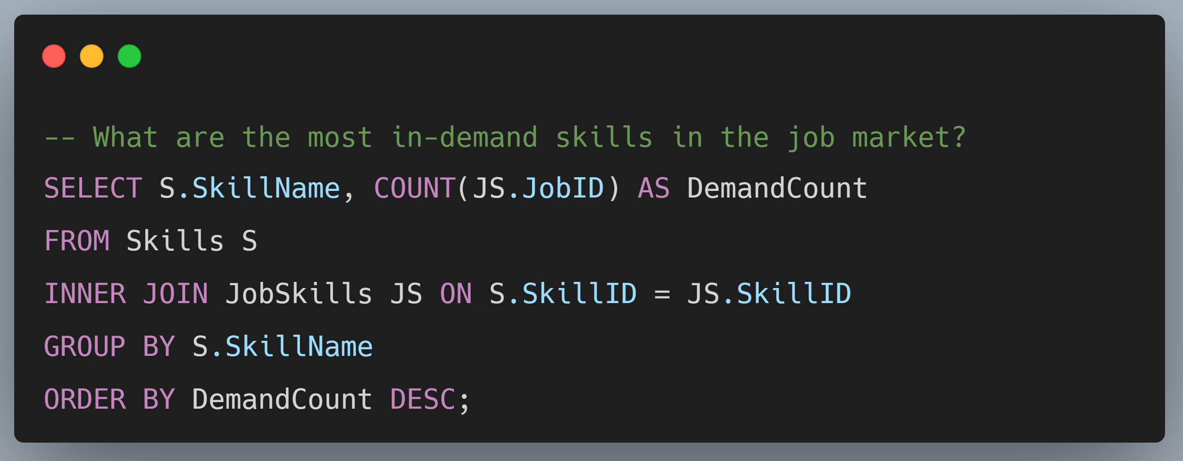

Slide 23
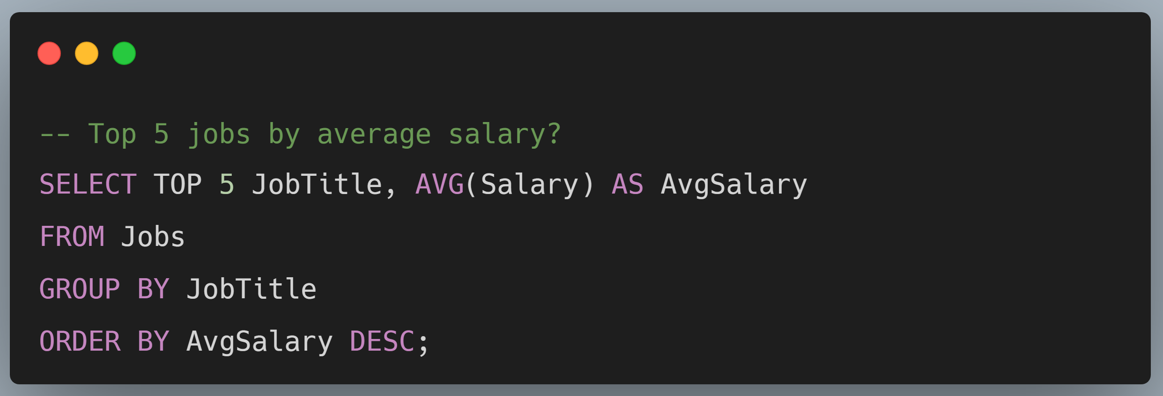

Slide 24
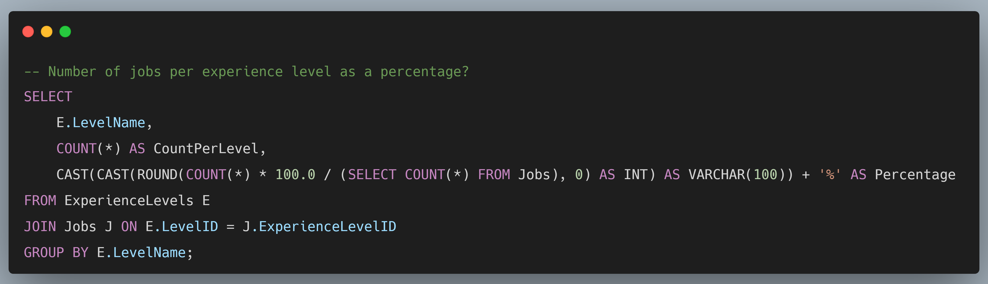

Slide 25
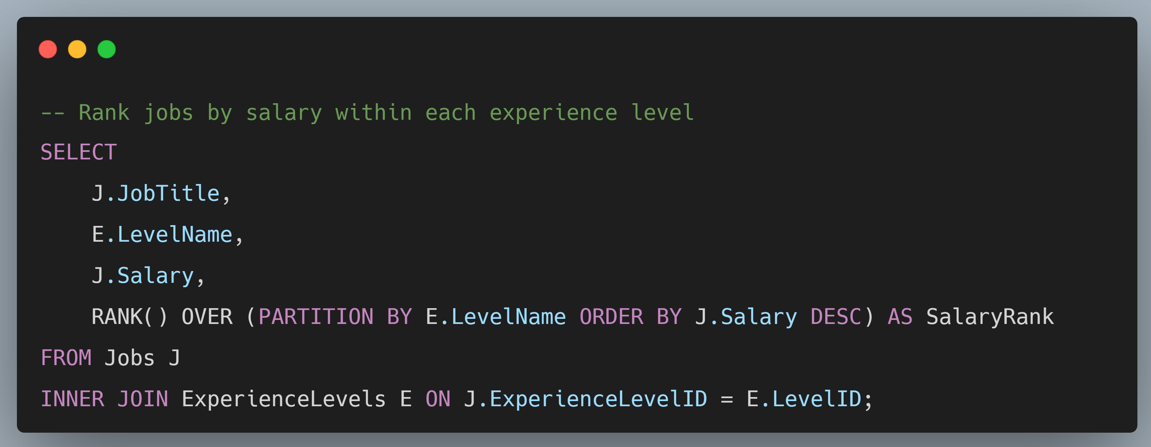

Slide 26
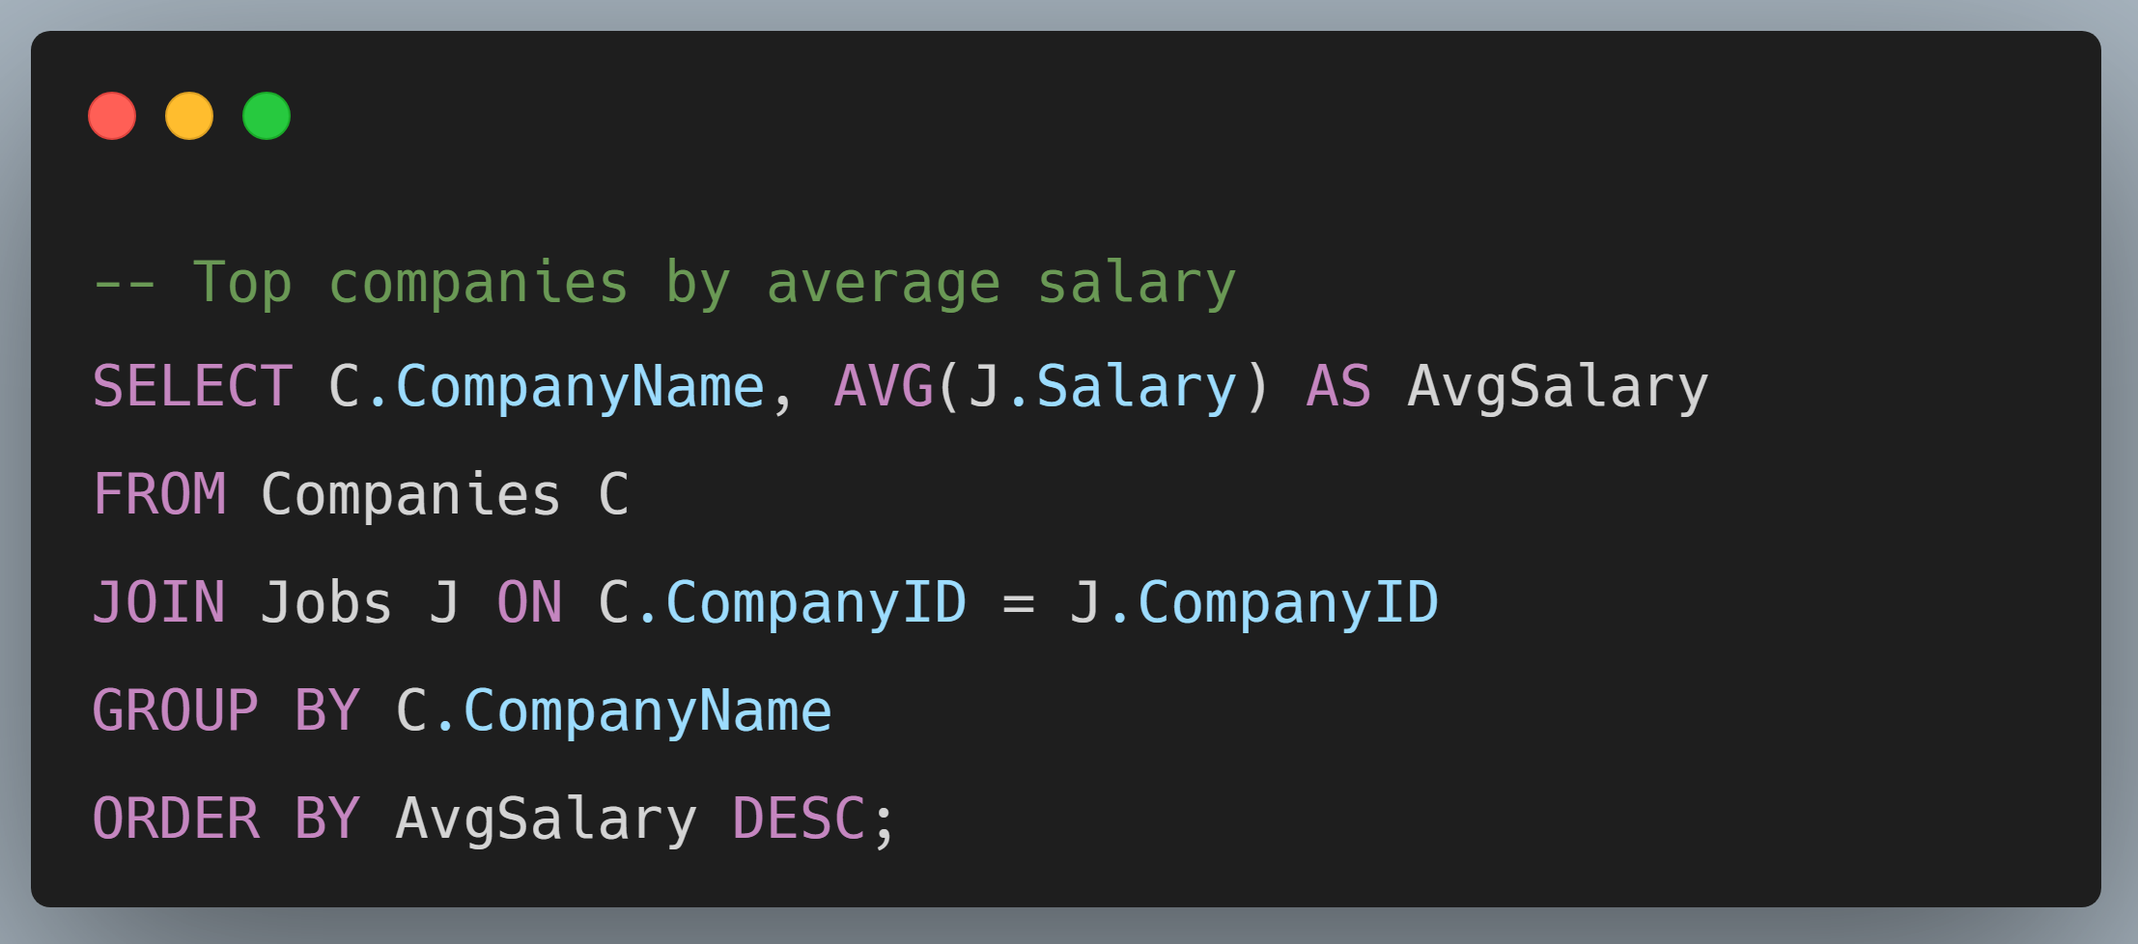

Slide 27

I hope you find my project valuable 🙏 ❤

